Slide 1





Version 1.0.0
Version 1.0.1
.
.
Version 2.0.1
HOW DO DEVELOPERS TRACK CODE AND COLLABORATE?
Notes:
How to attract participant on how to understand the use of Git and GitHub

Slide 2
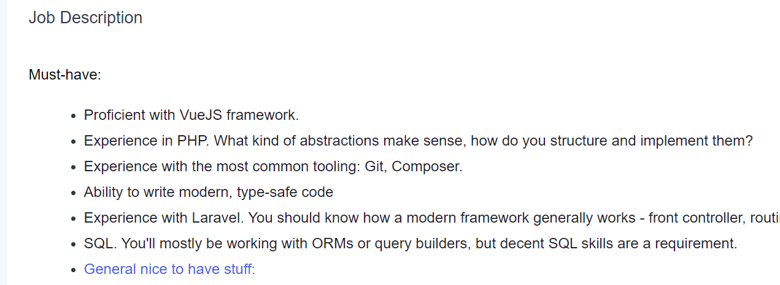
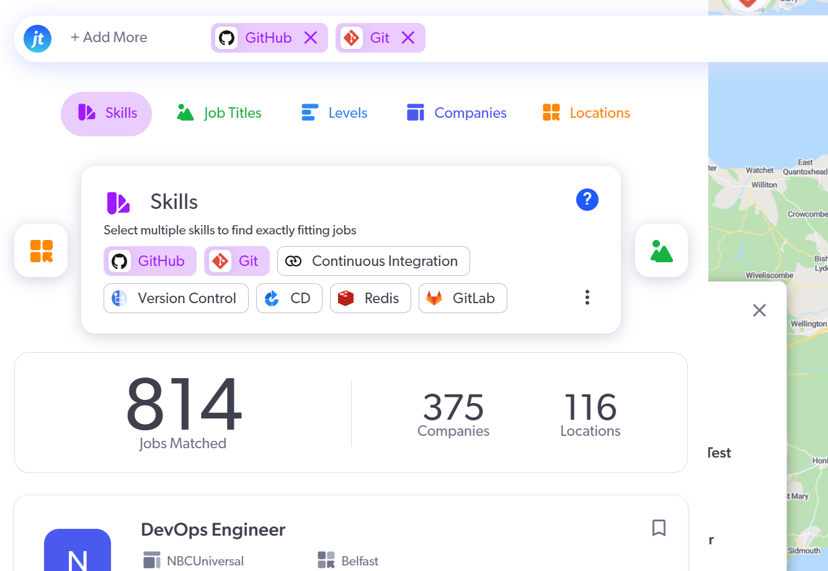
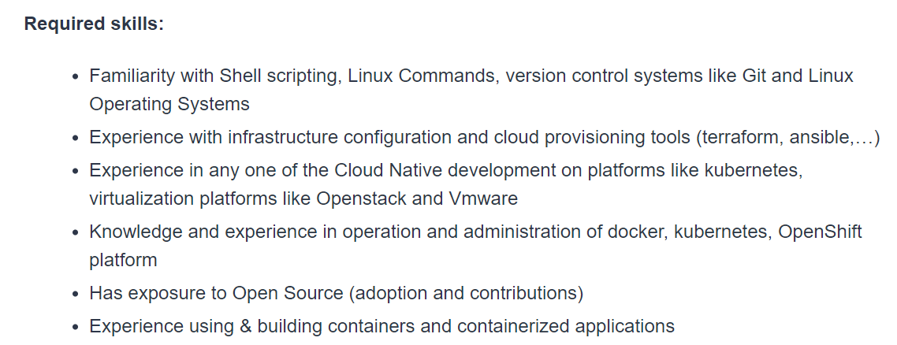
1
Jobtensor.com
2
JobStreet.com
Industry Need Git & GitHub Skills!
Notes:
How to attract participant on how to understand the use of Git and GitHub

Slide 3
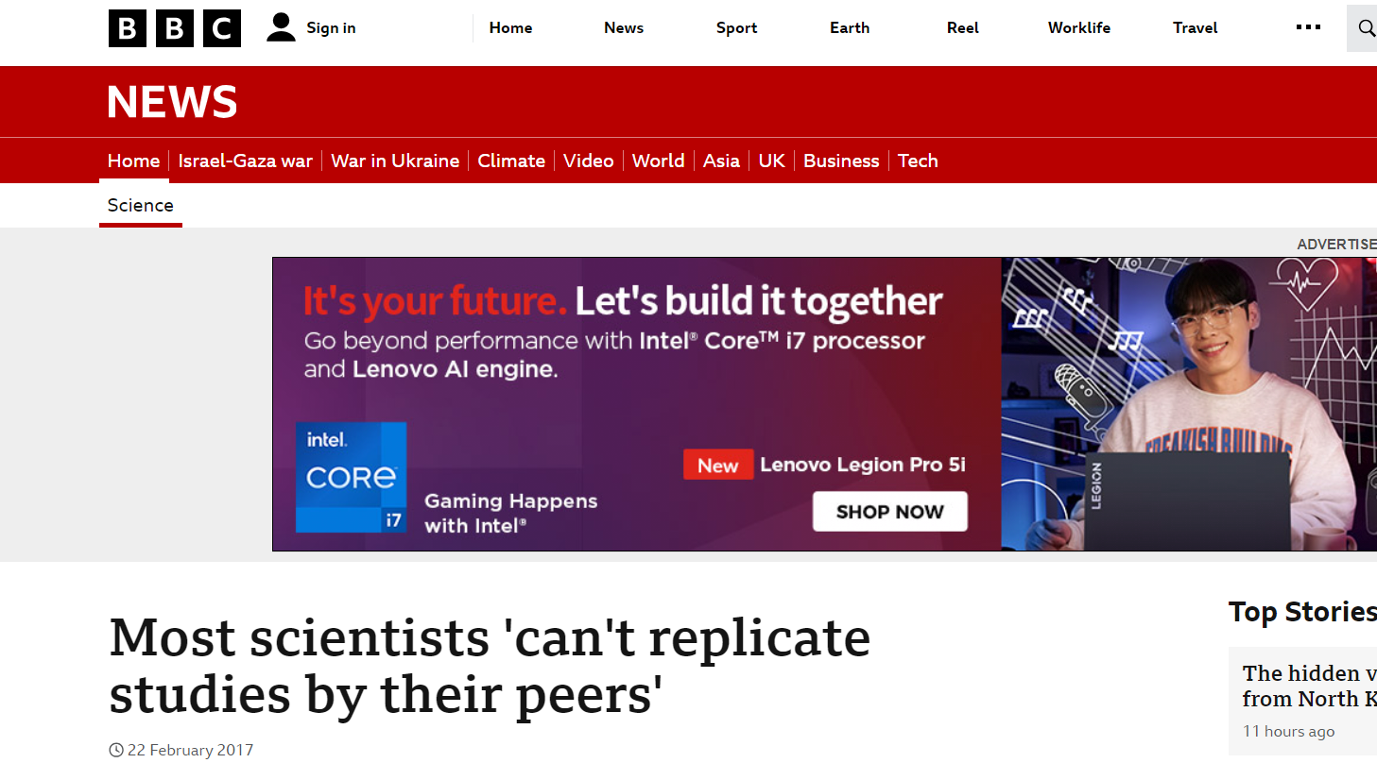
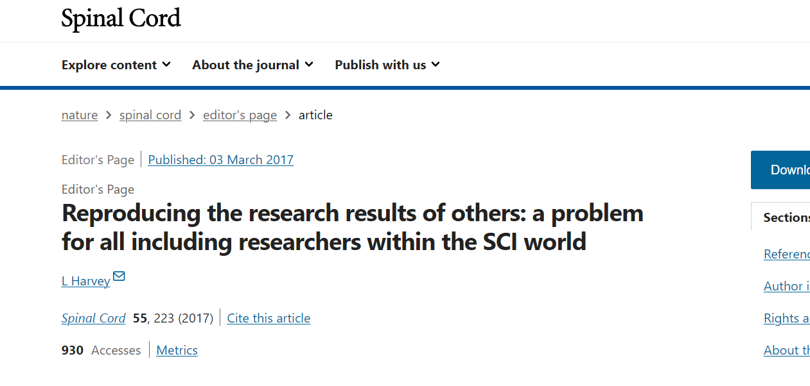
BBC NEWS
NATURE
Research reproducibility issue?

Slide 4
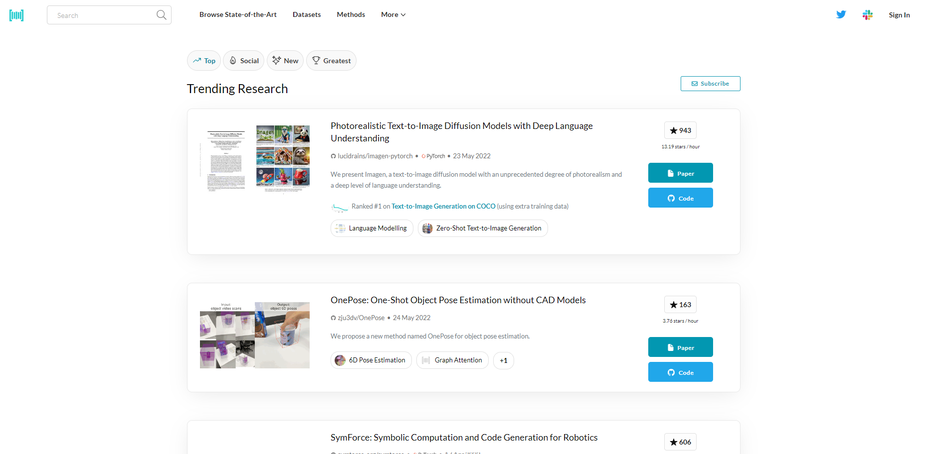
3
paperswithcode.com
Research Paper with Code
(Share @ GitHub)
Share Your Research Work!

Slide 5
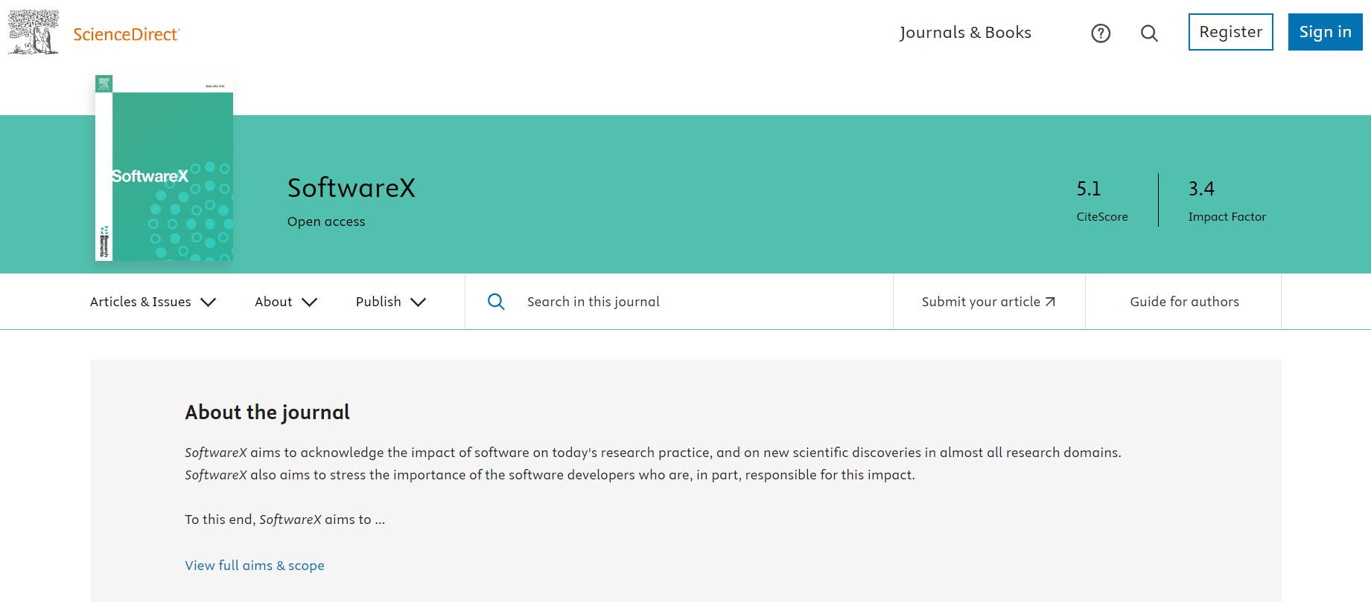
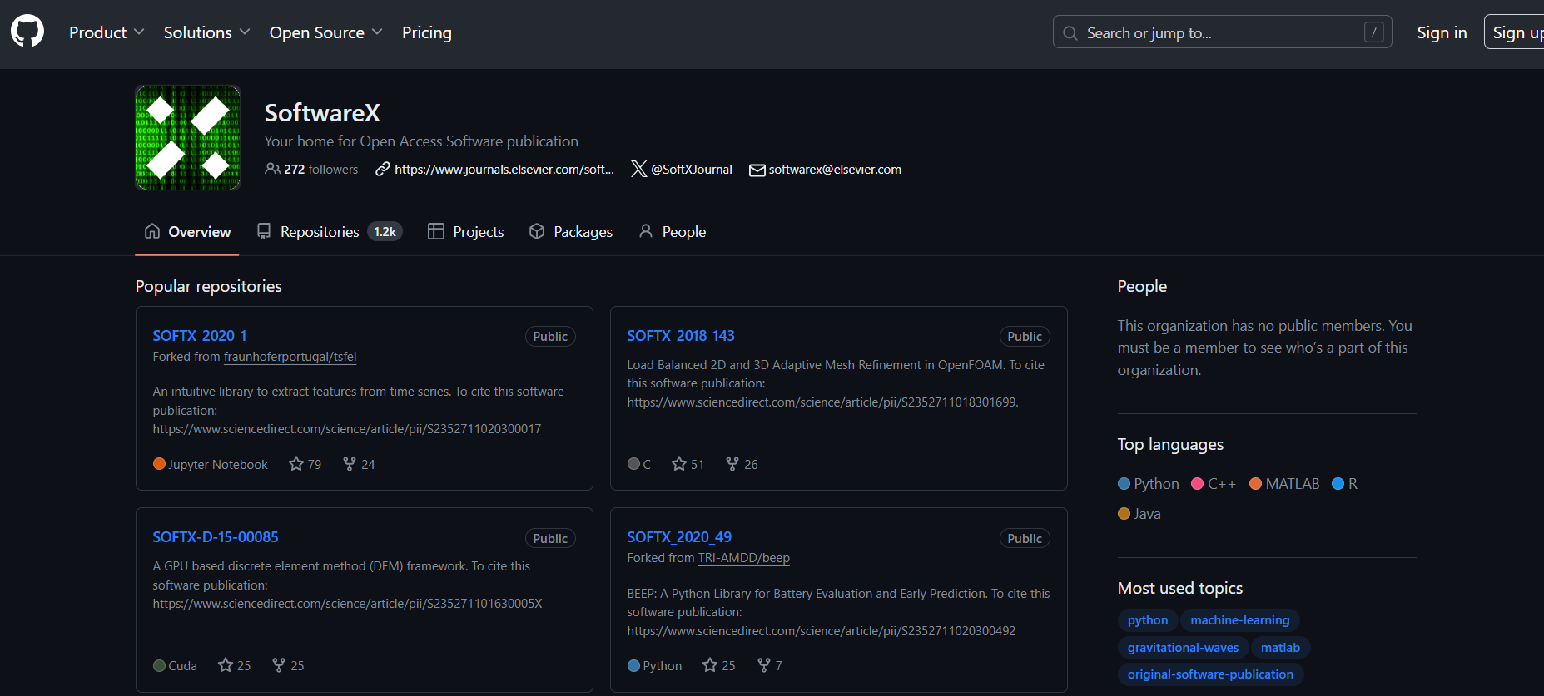
https://www.sciencedirect.com/journal/softwarex
https://github.com/ElsevierSoftwareX

Slide 6


Module 1 : Introduction to Version Control System
VERSION CONTROL SYSTEM!
Module 2 : Introduction to Git
Module 3 : Introduction to GitHub
Module 4 : Working with Git & GitHub

Slide 7

MODULE 1 :
INTRODUCTION TO VERSION CONTROL SYSTEM
PREPARED BY:
Dr. Nurulaqilla Khamis Center for Artificial Intelligence and Robotics
Universiti Teknologi Malaysia

Slide 8
MODULE OUTLINE
01
04
Version Control System – Purpose & Benefits
What is Version Control System (VCS)
02
05
What is Git?
Version Control System – Tracking Changes & Maintaining History
03
Overview of GitHub as Hosting Platform
06
Version Control System – Collaborative Development & Concurrent Work

Slide 9

01
WHAT IS VERSION CONTROL SYSTEM (VCS)

Slide 10
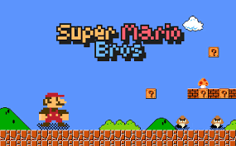



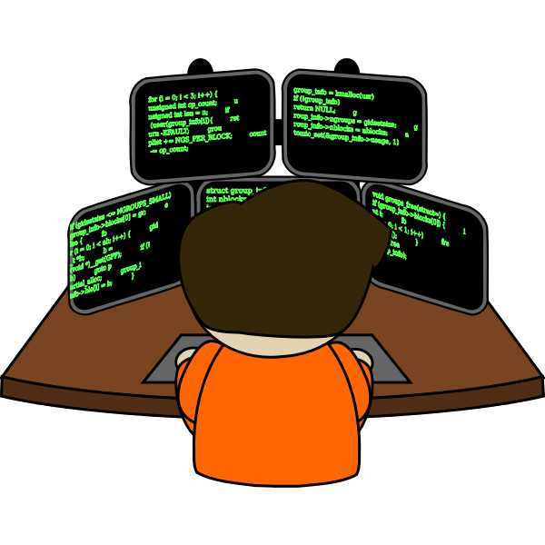

Character Movement & Controls
Enemy Behaviour
Single Source Code File – Developer 2
Single Source Code File – Developer 1
. . . . . . . . . . . . . . . . . . . . . .
NO MULTIPLE FILE CREATED FOR EACH USER
Script_v1.py
Script_v2.py
.
.
Script_v5.py
Developer 2
Developer 1
Notes:
Example game developer

Slide 11


NO MULTIPLE FILE CREATED FOR EACH USER
Script_v1.py
Script_v2.py
.
.
Script_v5.py
Single Source Code File – Researcher 1
Single Source Code File – Researcher 3
Single Source Code File – Researcher 3
Researcher 1
Researcher 3
Researcher 2
Notes:
Example source code for research

Slide 12

WHAT IS VERSION CONTROL SYSTEM (VCS)?
Time Machine for Files : go back in time and see every changes you’ve made to a document or project – keep track all the changes you make to your files over time
Track Changes Easily : who made changes, what changes were made and when they were made
Collaboration Made Simple : Everyone work on the same files
Undo Mistakes : Accidently delete something or mess up a file? Easily roll back to a previous file ☺

Slide 13
02
WHAT IS GIT?

Slide 14
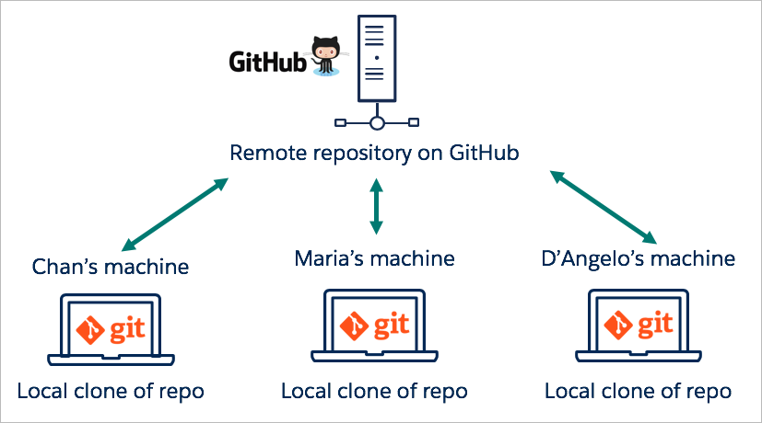
WHAT IS GIT?
Command used in Version Control System (VCS)
Set of commands that users can use to perform various version control tasks
Version control tasks : make copy of file, changes in file, file status, file history etc

Slide 15
03
OVERVIEW OF GITHUB AS
HOSTING PLATFORM

Slide 16
OVERVIEW OF GITHUB AS HOSTING PLATFORM
Web-based hosting platform for developers can share their work

Slide 17



OVERVIEW OF GITHUB AS HOSTING PLATFORM

Slide 18
04
VERSION CONTROL SYSTEM
PURPOSE & BENEFITS

Slide 19


PURPOSE & BENEFITS OF USING VERSION CONTROL SYSTEM
Command Line Interface (CLI)
To track changes, modify and version control:
version1
version2
.
.
versionN
Storage Space Your Project Repo/Online Hosting
Programmer
(Web Apps, Desktop Apps, Mobile Apps) / Researcher

Slide 20
05
VERSION CONTROL SYSTEM
TRACKING CHANGES & MAINTAINING HISTORY

Slide 21

TRACKING CHANGES & MAINTAINING HISTORY
To track changes, modify and update version of software
Software Developer/Programmer/Researcher
Share to the Users

Slide 22
06
VERSION CONTROL SYSTEM
COLLABORATIVE DEVELOPMENT & CONCURRENT WORK

Slide 23
COLLABORATIVE DEVELOPMENT & CONCURRENT WORK
Create Project Repositories
at Central Repo
Git Installation & Configuration
git config --global user.name “[firstname lastname]”
git config --global user.email “[valid-email]”
Initialize Repositories (Locally)
from Local Machine

Slide 24
cairo@utm.my / trainer’s email

